Slide 1
Rockbuster Data Analysis Project
Brandee Fairnot July 2023
Notes:
My project is based on the questions from the brief that needed to be answered.

Slide 2
Questions from Rockbuster
Which movies contributed the most/least to revenue gain?
What was the average rental duration for all videos?
Which countries are Rockbuster customers based in?
Where are customers with a high lifetime value based?
Do sales figures vary between geographic regions?

Slide 3
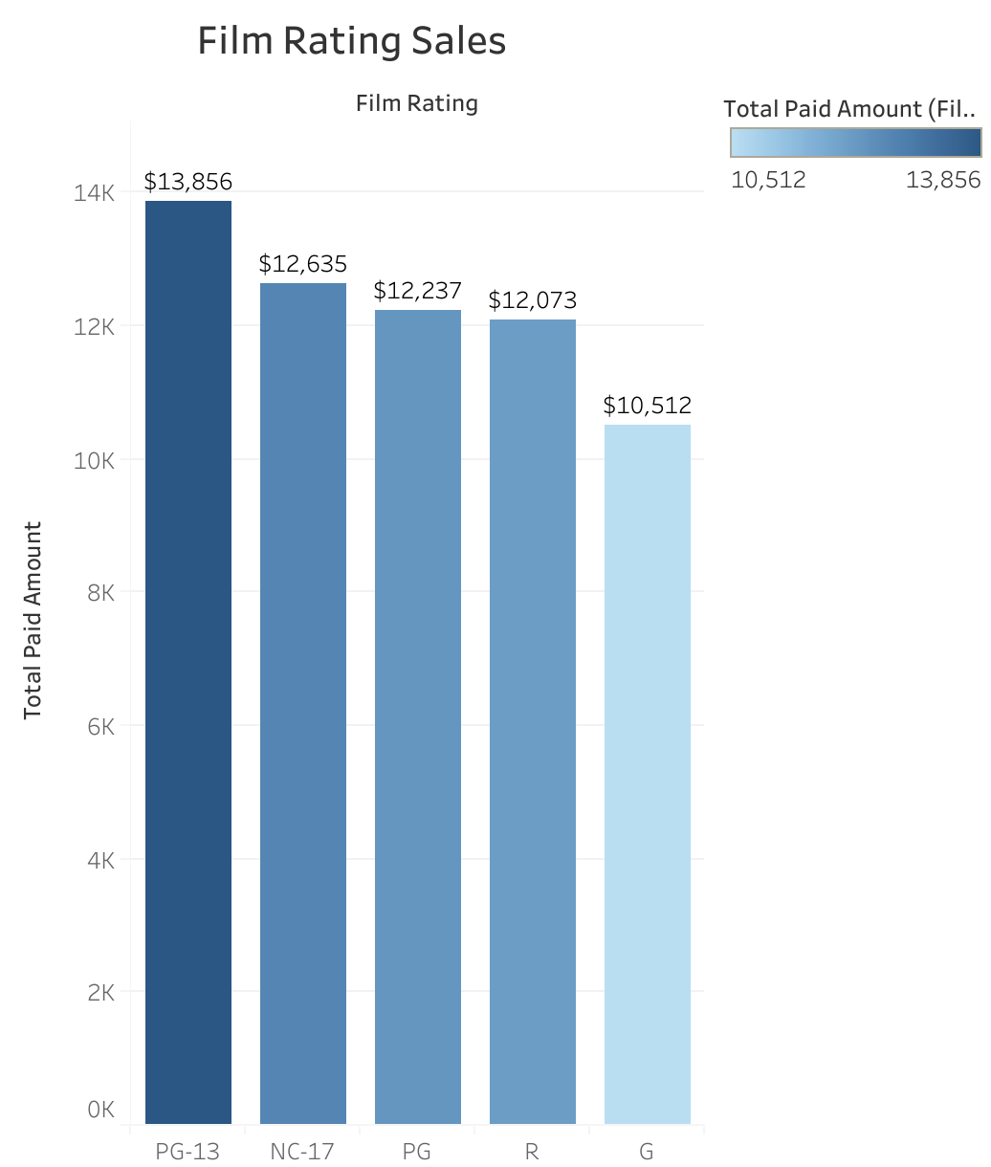
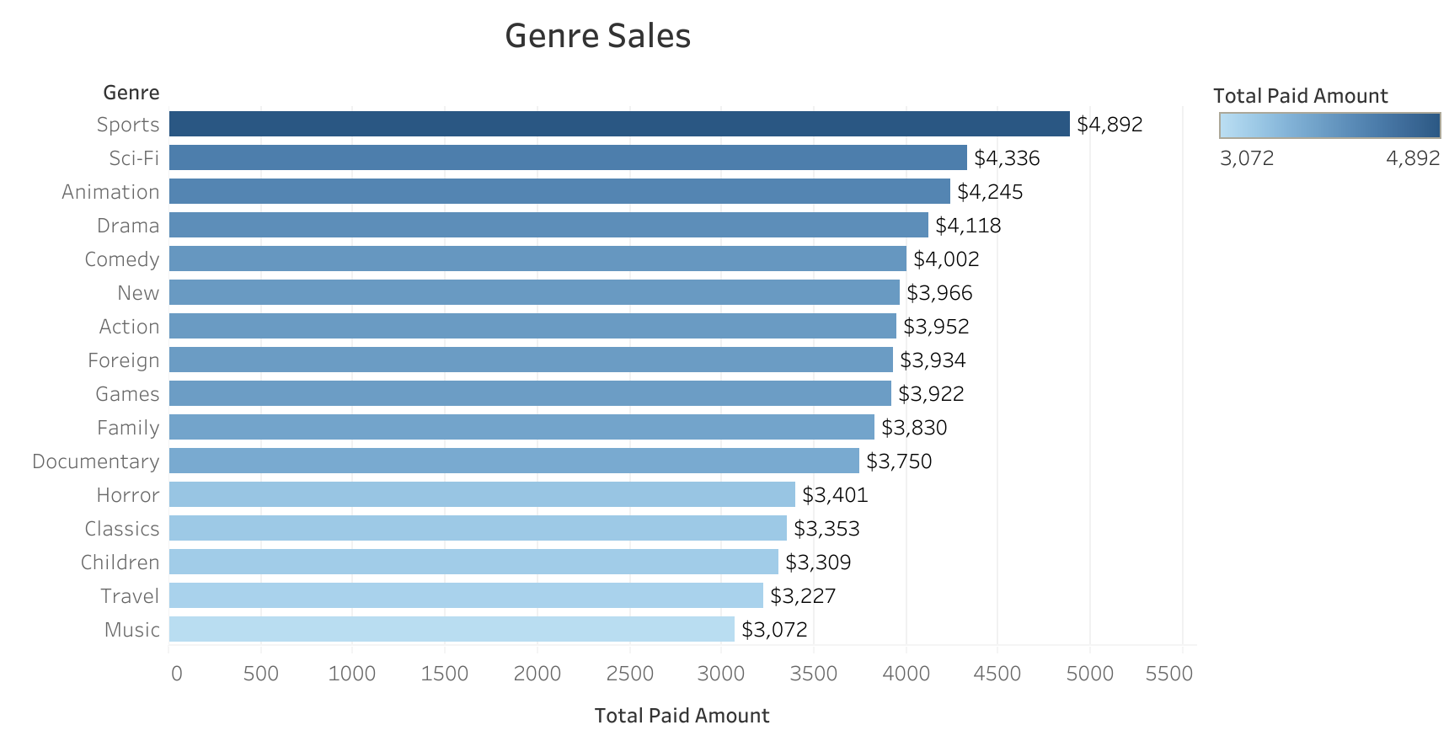
Which movies contributed the most/least to revenue gain?
Notes:
I’ve separated the information into Sales by genre and sales by Film rating to provide the stakeholders with differing aspects of the data. PG-13 rated movies sold the best in ratings, while G rate movies sold the least, but only by a little under $3000. The genre top and bottom sellers and were a lot closer in comparison of revenue. Sports genres sold the most, while sold the least. As you can see above there is only a $1820 difference from the most popular and least popular genres.

Slide 4
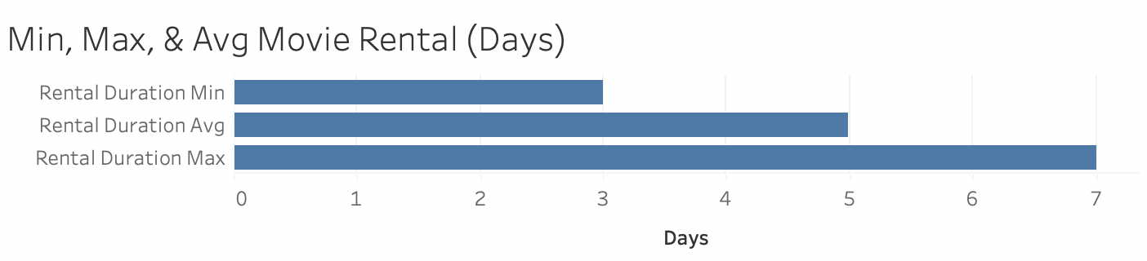
What was the average rental duration for all videos?
Notes:
It is shown here that movies are rented on average for 4.9 (or 5) days. The minimum is usually 3 days, and the maximum is 7 days for a rental.

Slide 5

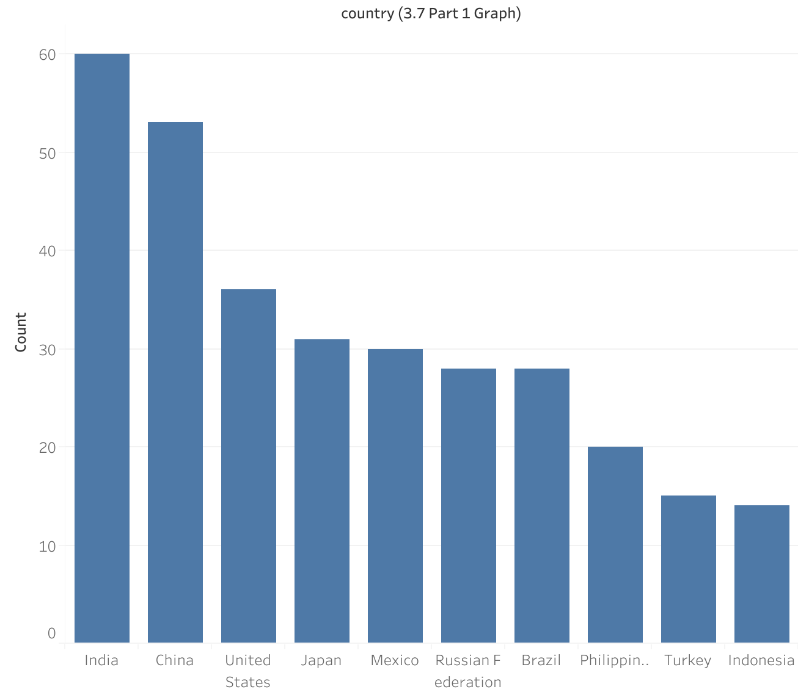
Which countries are Rockbuster customers based in?
Notes:
This slide represents the top 10 Countries with the most customers. There are no more than 60, but no less than 14 customers for the top 10 countries that consume Rockbuster films.
India
China
United States
Japan
Mexico
Russia
Brazil
Philippines
Turkey
Indonesia

Slide 6
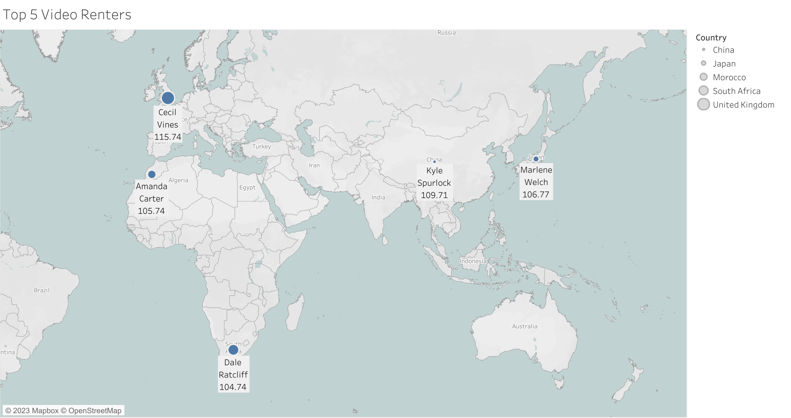
Where are customers with a high lifetime value based?
Notes:
This Slide represents the 5 highest paying customers from the top 10 cities in the world who frequent Rockbuster. We can see their locations are not in any central location and they are spread out on the eastern half of the hemisphere.

Slide 7
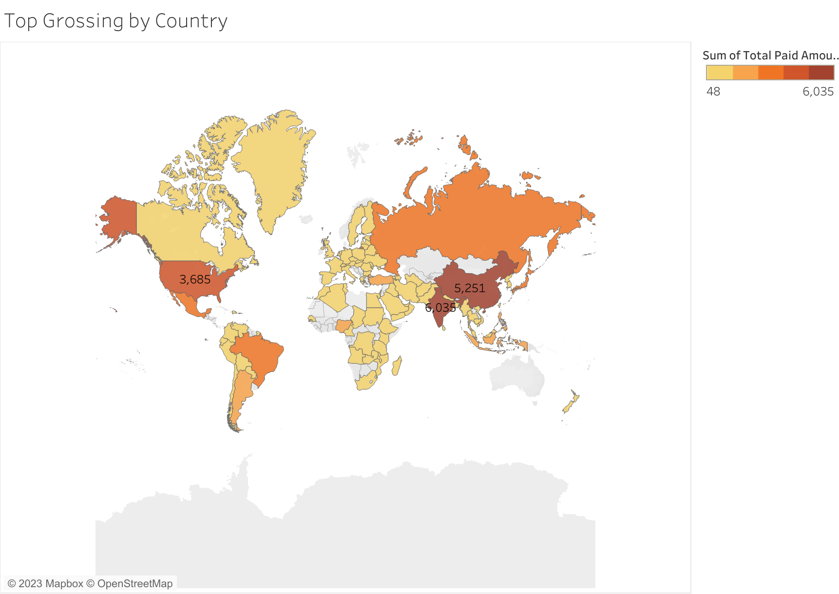
Do sales figures vary between geographic regions?
Notes:
Yes. In the US, China, and India, Rockbuster sales are the highest, while most smaller countries barely have over $1,000 in sales.

Slide 8
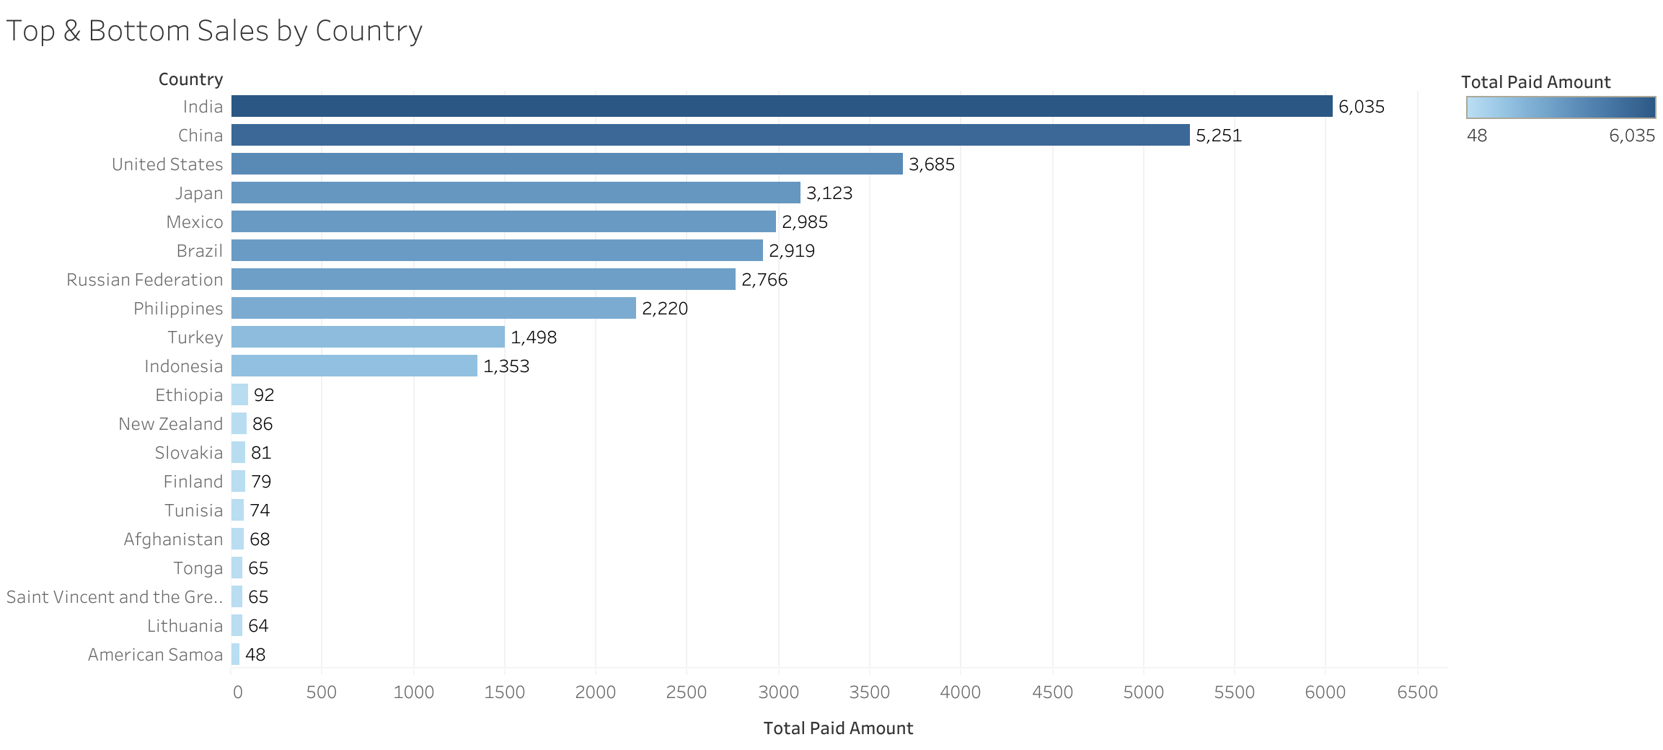
Do sales figures vary between geographic regions?
Notes:
As a continuation of the previous slide. This graph displays the top 10 and bottom 10 countries based on their rental sales. Smaller island countries seem to have less sales while 1st world countries provide Rockbuster with most of their revenue.

Slide 9
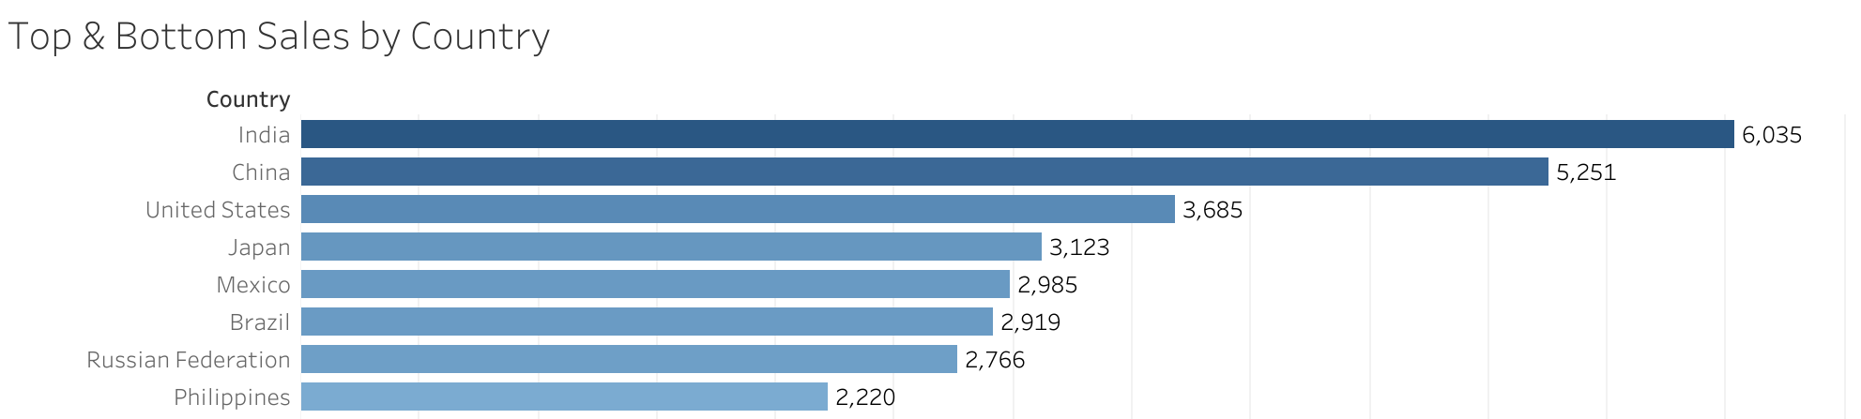
Solution / Conclusion
Rockbuster should focus sales in the top 8 countries
India
China
United States
Japan
Mexico
Russia
Brazil
Philippines
Movies with a rating of PG-13 have the highest rating, so those movies should be prioritized based on the amount of customers that can consume the product
Most people rent movies for 5 days, so if Rockbuster cap rental days at 4 days with a renewal/late rate on the 5th day. They may be able to bring in more revenue.

Slide 10
Tableau URLs
Genre & Rating sales https://public.tableau.com/app/profile/brandee.fairnot/viz/CategoryFilmSales/GenreSales?publish=yes
Top Customers https://public.tableau.com/app/profile/brandee.fairnot/viz/top10countries_16887024009450/Top10countries?publish=yes
Min Max Days https://public.tableau.com/app/profile/brandee.fairnot/viz/MinMaxAvgMovieRental/MinMaxAvgMovieRentalDays?publish=yes
Top & Bottom Grossing Countries https://public.tableau.com/app/profile/brandee.fairnot/viz/TopBottomGrossingCountries/TopBottomSales?publish=yes

